Slide 1
More DataVerse
Tables and Relationships

Slide 2
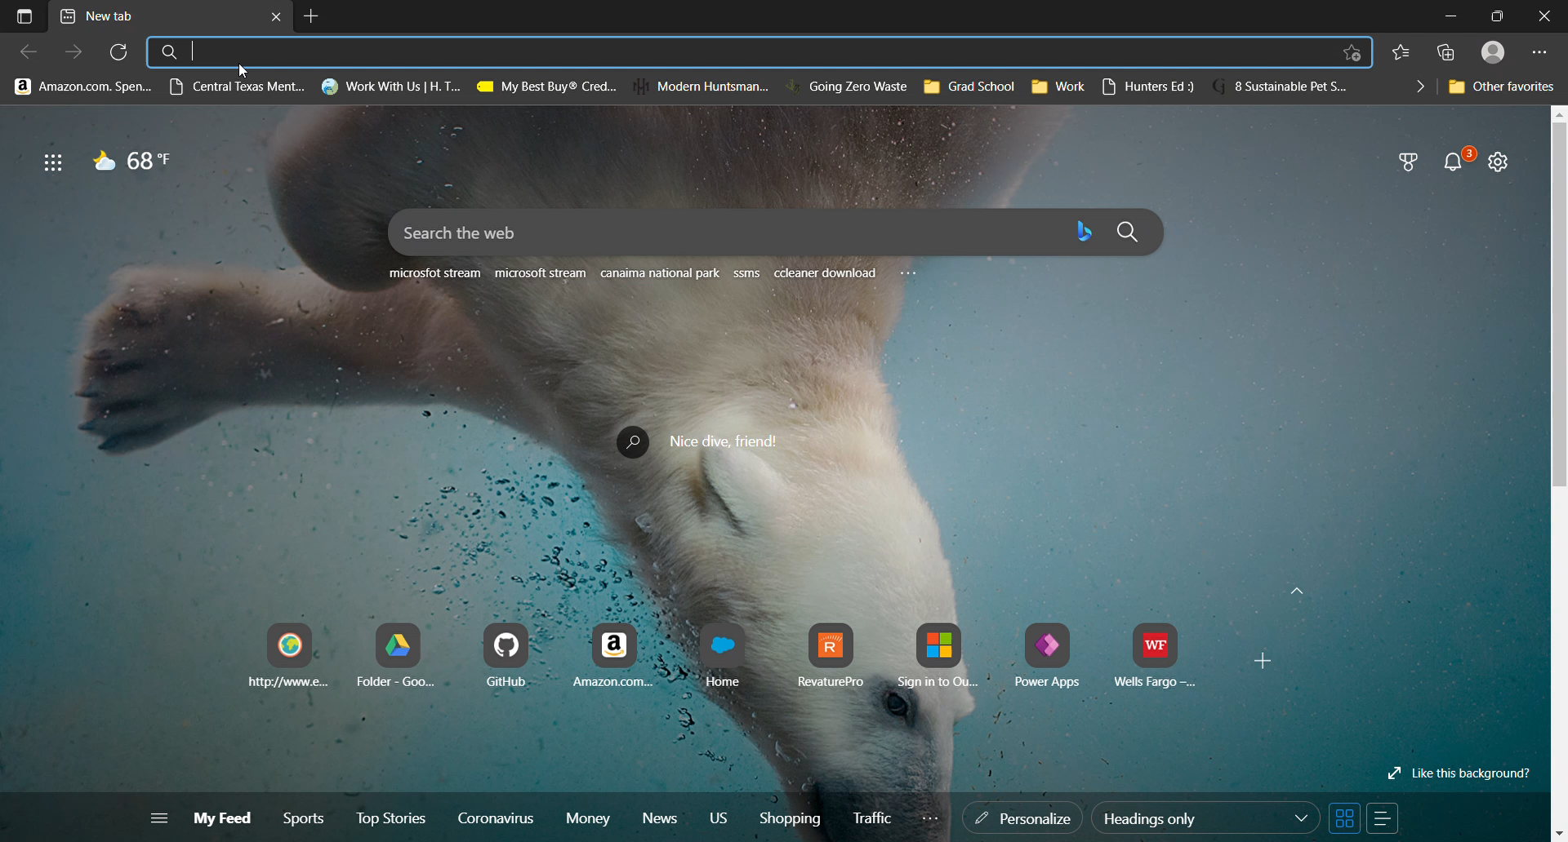
How to create tables
PowerApps > Dataverse >
Tables > New Table
Tables are also called entities

Slide 3
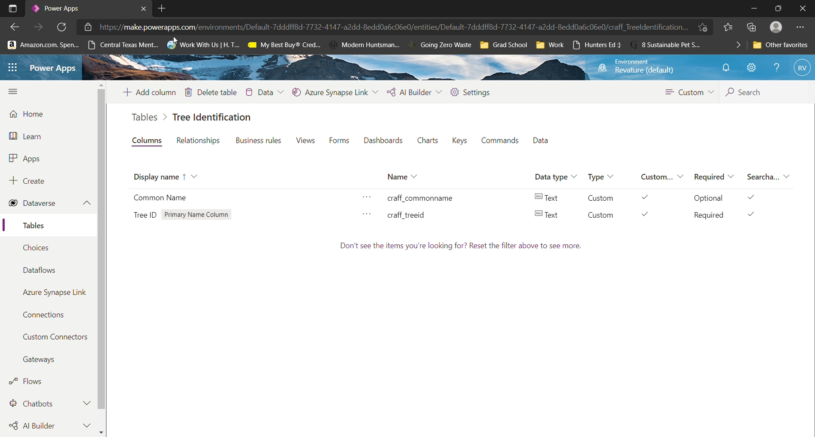
How to create Relationships
PowerApps > Dataverse >
Tables >
Select Desired Table >
Relationship >
Add Relationship
Or via adding Columns
See video
Notes:
To save time, I have also made a Genus table that will be used for this demo

Slide 4
Relationships Supported
One-to-Many (1:N) - One table row for the Primary table can be associated to many other Related table rows because of a lookup column on the related table.
Many-to-One (N:1) – same definition as above
Many-to-Many (N:N) - A table relationship that depends on a special Relationship table, sometimes called an Intersect table, so that many rows of one table can be related to many rows of another table.
Notes:
Definitions from: About table relationships for Microsoft Dataverse - Power Apps | Microsoft Docs

